Slide 1
Unconference Talk Topic:
Proxy Server

Slide 2
Index
How the Web Works?
Without Proxy Servers
What is Proxy Server?
Why do we need to use Proxy Server?
Types of Proxy Server
What Proxy Servers can’t do?
VPNs
Apple used Two Proxy Servers to create a feature
How can it be helpful?
NCR Coin Code

Slide 3
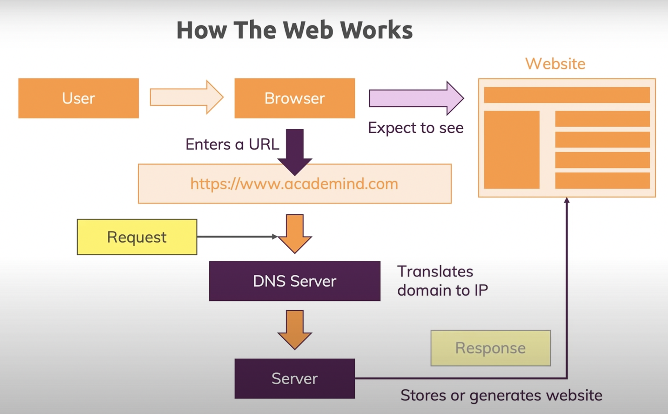
How the Web Works

Slide 4
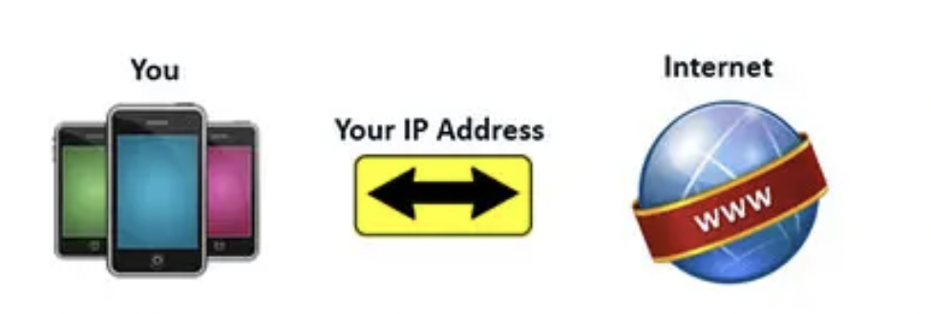
Without Proxy Server
User request specific web page, the request directly goes to the server.
Server gives a response directly to the user.
no content filtering or security layer
no encryption in the messages
Server knows your external IP. This IP is sufficient to know your approximate geographical location.
Access any cookies that are available on your computer.
It knows your browser details, details of your browser plugins, OS version, and more.

Slide 5
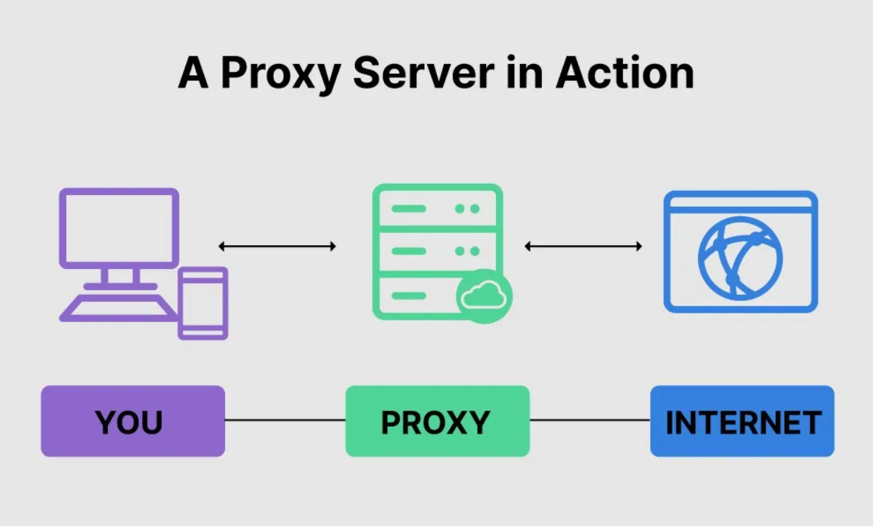
With Proxy Server
A system or router that provides a gateway between users and the internet. Therefore, it helps prevent cyber attackers from entering a private network. It is a server, referred to as an “intermediary” because it goes between end-users and the web pages they visit online.

Slide 6
Why do we need to use Proxy Servers
Performs the function of a firewall and filter.
End-user or a network administrator can choose a proxy designed to protect data and privacy.
Examines the data going in and out of your computer or network.
Applies rules to prevent you from having to expose your digital address to the world.
Only the proxy’s IP address is seen by hackers or other bad actors.
Without your personal IP address, people on the internet do not have direct access to your personal data, schedules, apps, or files.

Slide 7
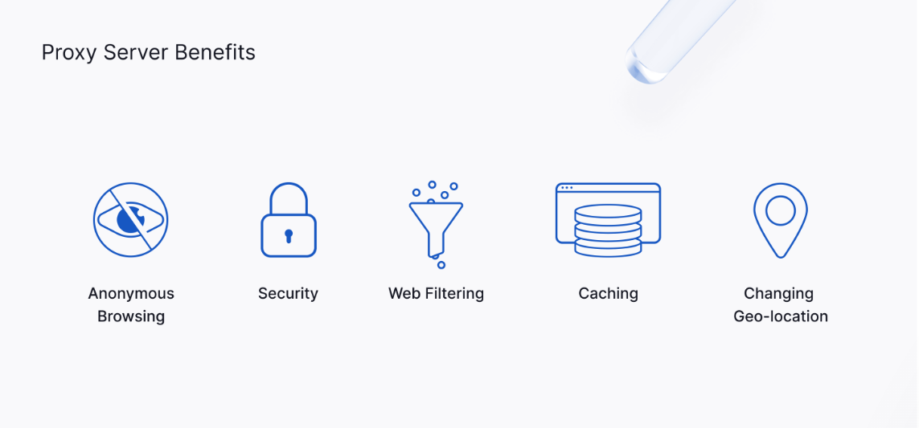
Benefits of Proxy Servers
Anonymous Browsing: allow users to browse the web anonymously.
Security: Some proxy server types (e.g., HTTPS proxies) can be configured to provide secure connections through encryption.
Web filtering: proxies used to restrict employees from accessing certain websites. it also log user activity, allowing organizations to monitor employees' Internet use at work.
Web acceleration: Proxy servers can speed up data transfer and conserve bandwidth by caching popular websites.
Changing Geo-Location: Rotating proxies for Internet-based marketing.
Notes:
Additional Data:
It allow users to browse the web anonymously by concealing their IP addresses.
Some proxy server types (e.g., HTTPS proxies) can be configured to provide secure connections through encryption. Organizations can use these proxies to block certain websites that are flagged as malware. It can also block malicious emails, such as phishing attacks, from reaching employee inboxes. they are also effective at helping organizations prevent Distributed Denial of Service (DDoS) attacks and man-in-the-middle (MITM) attacks by blocking suspicious and repeated requests.
Organizations often use proxies to restrict employees from accessing certain websites. it also log user activity, allowing organizations to monitor employees' Internet use at work.
Proxy servers can speed up data transfer and conserve bandwidth by caching popular websites. When a user requests data from a server via a proxy, the proxy will first check if a cached copy is available in its database. Cached data reduces the number of web requests from the proxy server, making data retrieval much faster for the user. Reverse proxy servers are often used for load balancing, which spreads user requests evenly across servers to improve speeds.
Organizations can use rotating proxies for Internet-based marketing activities where data is dependent on geo-location. Such activities could include price aggregation, web scraping, market research, and SEO.

Slide 8
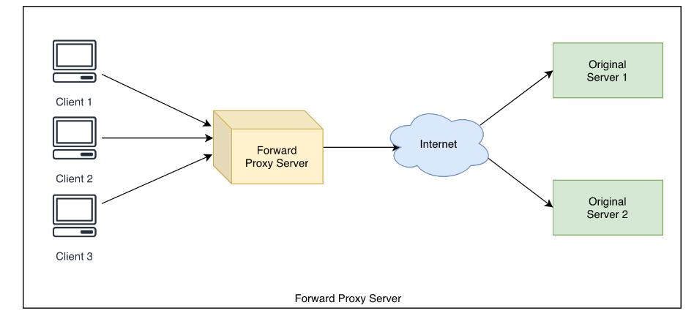
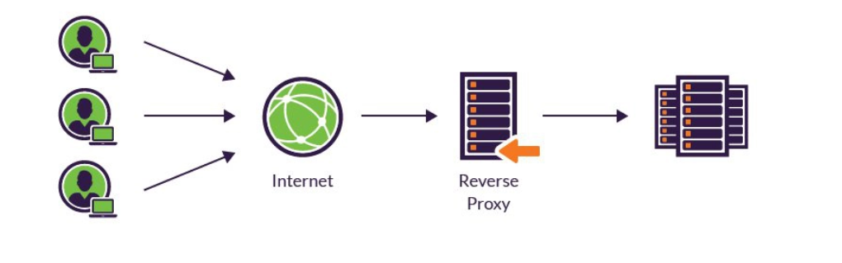
Types of Proxy Servers
Forward Proxy
A forward proxy is the most common form of a proxy server and is generally used to pass requests from an isolated, private network to the Internet through a firewall.
Reverse Proxy
In computer networks, a reverse proxy is the application that sits in front of back-end applications and forwards client requests to those applications. Reverse proxies help increase scalability, performance, resilience and security.

Slide 9
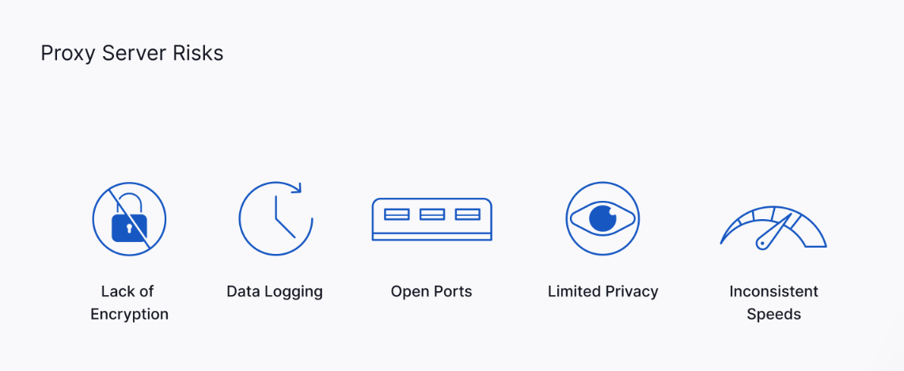
What Proxy Servers Can’t do?
Like any third-party service operating over the Internet, proxy servers are not without their cyber risks. Users should understand the common risks associated with proxies to decide if they are fit-for-purpose.
Lack of encryption: Unless a proxy is configured with encryption, it will operate through an unsecured connection.
Data logging: Proxy servers store users' IP addresses along with their web request data.
Open ports: Most proxies run on open ports, which can be exploited through security vulnerabilities.
Limited privacy: Free proxies often operate over unsecured networks and ad-based revenue models.
Inconsistent speed: Free proxies are susceptible to traffic overload.
Notes:
Additional Data:
Unless a proxy is configured with encryption, it will operate through an unsecured connection. Attackers can easily intercept communications over unsecured proxies, meaning any sensitive data like usernames and passwords are at risk of being compromised. Unsecured connections also put users at high risk of data breaches, such as identity theft. Users should ensure they are using encrypted proxies to maximize network security.
Proxy servers store users' IP addresses along with their web request data. Some proxies do not encrypt this information and, depending on the service, may even sell the data to other parties - once again, putting users at risk of data breaches. Users should always read the terms and conditions before using a proxy.
Most proxies run on open ports, which can be exploited through security vulnerabilities. Open ports also increase security risks as they increase an organization's total number of attack vectors.
While proxy servers conceal users' IP addresses, this privacy does not necessarily extend beyond web requests. Free proxies often operate over unsecured networks and ad-based revenue models. Not only does this mean that anyone can ‘listen' to user traffic, but these ads are often injected with viruses or other types of malware, which can easily infiltrate devices.
Free proxies are susceptible to traffic overload. Servers often do not have the necessary bandwidth to serve thousands of users at once with maintained speeds and are prone to lagging.

Slide 10
VPNs
VPN stands for "virtual private network" — a service that helps you stay private online.
A VPN establishes a secure, encrypted connection between your computer and the internet, providing a private tunnel for your data and communications while you use public networks.

Slide 11
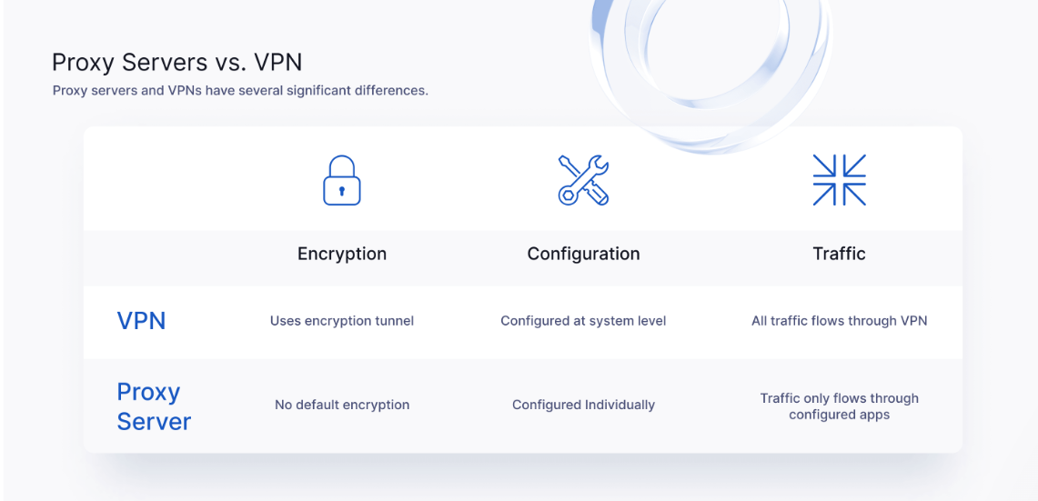
VPNs Vs Proxy Server
VPNs create an encrypted tunnel between a user's device and the outside network.
Proxy servers are often cheaper and faster than VPNs.
Proxies need to be configured individually across apps.
Web-based proxies are advantageous over VPNs on devices where users can't change software settings if privacy is not a significant concern.
A proxy server can't encrypt data on its own; it just changes a user's IP address.
Notes:
Additional Data:
VPNs are more secure than proxy servers due to the way they operate. VPNs create an encrypted tunnel between a user's device and the outside network. So, basically The tunnel allows users to browse the web without sharing their IP address and other identifying connection data.
Proxy servers are often cheaper and faster than VPNs because they usually do not offer secure connections.
VPNs can be used across an entire system as most apps can't recognize when they are connected through an encrypted VPN tunnel. Proxies need to be configured individually across apps.
Web-based proxies are advantageous over VPNs on devices where users can't change software settings if privacy is not a significant concern. But in this Users should be careful not to share personally identifiable information (PII), or login credentials like usernames and passwords, over web-based proxies.
A proxy server can't encrypt data on its own; it just changes a user's IP address. VPNs change a user's IP address and encrypt the data transfers between the device and Internet, allowing private and secure web browsing.

Slide 12


Private Relay
iCloud Private Relay "keeps your internet activity private"—and it does that in several ways.
Hiding your IP address from the websites that you visit.
The service encrypts your data as it leaves your device.
Finally, it also keeps your DNS (Domain Name System) queries secret—essentially, the websites you're looking up on your device.
Notes:
Additional Data:
iCloud Private Relay "keeps your internet activity private"—and it does that in several ways. One way is by hiding your IP address from the websites that you visit: Your IP address indicates where in the world you're connected to the web, and it's one of the key pieces of information that sites, and marketers use to work out who you are.
As an additional flourish, this service encrypts your data as it leaves your device, which means no one can digitally eavesdrop on your communications.
Finally, it also keeps your DNS (Domain Name System) queries secret—essentially, the websites you're looking up on your device. As with IP addresses, this data can be used to create a profile of who you are and what you're interested in, which in turn can be sold to advertisers.

Slide 13
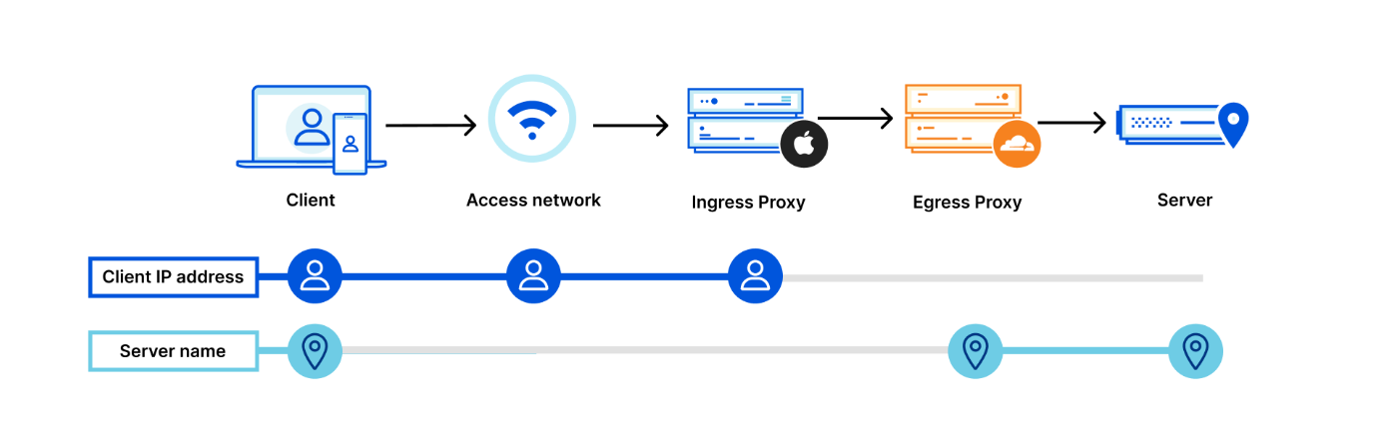
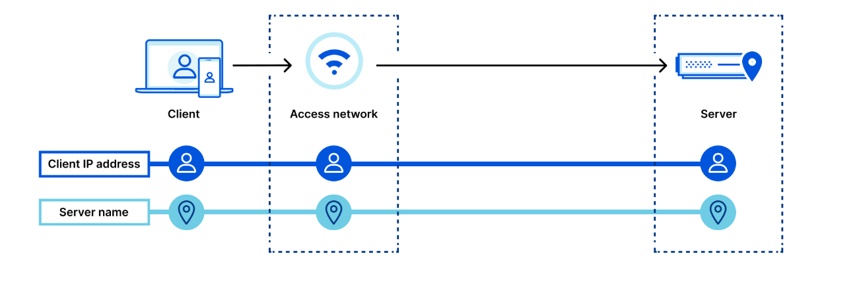
How it Works?
iCloud Private Relay deploys what Apple calls "dual-hop" architecture—there are two stops or relays between your device and the internet.
One stop is run by Apple, where the IP address is visible but the name of the website you're visiting is encrypted
Second stop is run by Apple's "third-party partners" and knows the website you're visiting but not what your IP address is (it has the responsibility of assigning a new IP address for you).
No one gets to see every bit of information
IP addresses assigned to you by the second relay are rotated over time and between sessions, making it even harder for you to be tracked.
Notes:
Additional Data:
iCloud Private Relay deploys what Apple calls "dual-hop" architecture—there are two stops or relays between your device and the internet. One stop is run by Apple, where the IP address is visible but the name of the website you're visiting is encrypted; the second stop is run by Apple's "third-party partners" and knows the website you're visiting but not what your IP address is (it has the responsibility of assigning a new IP address for you).
No one gets to see every bit of information: Apple and your Internet Service Provider (ISP) get to see who you are but not where you're going, while the content delivery network (CDN) running the second relay can see where you're going but not who you are. Each part of the process is kept separate to protect your privacy.
To make the process even more effective, the IP addresses assigned to you by the second relay are rotated over time and between sessions, making it even harder for you to be tracked. The service is also designed so that new CDN partners can be brought in and plugged into the system without any disruption from the user perspective.

Slide 14
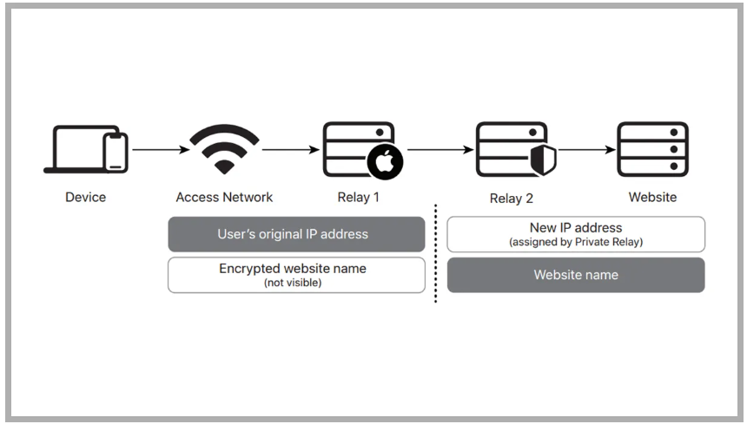
Two Proxy Servers
Instead of “tunneling” your data like a VPN, Private Relay uses two different proxy servers to hide your information.
When you access browser and go to a website,
Device connects to the first server, which is run by Apple.
configure the Private Relay settings to widen the scope of the random IP address that gets assigned to you, to your country and time zone.
Sends your data to the second server, via an encrypted connection. The second server’s job is to decrypt the info and send the right website.
Why does Private Relay use two servers? The first server knows your IP address but doesn’t see the content you’re trying to access. The second server knows the content you want to access but doesn’t know your IP address.
Notes:
Additional Data:
Instead of “tunneling” your data like a VPN, Private Relay uses two different proxy servers to hide your information.
When you access browser and go to a website, your device connects to the first server, which is run by Apple. The first proxy server does not know which website you’re visiting, and Apple cannot see what you’re doing. It also replaces your exact location with an approximate one.
Once the first server has done its job, it sends your data to the second server, via an encrypted connection. The second server’s job is to decrypt the info so it can send you to the right website. However, the second server doesn’t know your IP address, only the information you are trying to access. So, it picks a random IP address from your approximate location, assigns it to you, and connects to the website.
Why does Private Relay use two servers? The first server knows your IP address but doesn’t see the content you’re trying to access. The second server knows the content you want to access but doesn’t know your IP address.

Slide 15
How can it be helpful?
NCR also uses VPNs (third party) in many places.
If we replace VPNs with this solution what we will be getting:
More control on what is happening in between sending and receiving requests
Data Logging will be with NCR only
Encryption policy will be of NCR only
Increase security policies as per solution requirements
No need to install or download additional software for support
Cost will also be reduced which are given to third party VPNs
Faster than VPNs

Slide 16
NCR COIN CODE
MT8119

Slide 17
THANK YOU

